Slide 1
HUTCHINSON ELEMENTARY BUDGET FEEDBACK MEETING
To be presented to GO Team BEFORE the school staffing conference

Slide 2
NORMS
This is a meeting of the GO Team. Only members of the team may participate in the discussion. Any members of the public present are here to quietly observe.
We will follow the agenda as noticed to the public and stay on task.
We invite and welcome contributions of every member and listen to each other.
We will respect all ideas and assume good intentions.

Slide 3
GO TEAM BUDGET DEVELOPMENT PROCESS
YOUR SCHOOL STRATEGIC PLAN…
is your roadmap and your role.
It is your direction, your priorities, your vision, your present, your future.
Step 1: Data Review
Step 2: Strategic Plan Review
Step 3: Budget Parameters
(Strategic Priorities)
Step 4: Budget Choices
Notes:
Today I will provide an overview of the budget allocations for FY23. We will begin the work of funding the strategic priorities we agreed upon during our strategic review meeting. (IF YOU HAVE NOT DECIDED ON YOUR PRIORITIES, YOU WILL SAY – WE WILL DECIDE ON OUR PRIORITIES AND THEN DISCUSS ALLOCATING FUNDS TO ADDRESS THOSE PRIORITIES).

Slide 4
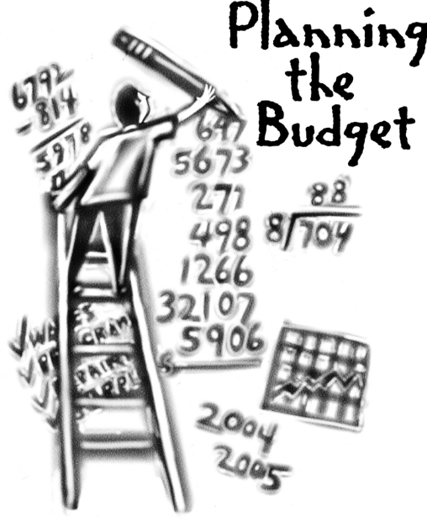
Overview of FY ‘24 GO Team Budget Process
Step 7 GO Team Final Budget Approval Meeting
Budgets Approved by March 17
Step 6 Principals: HR Staffing Conferences Begin
Late February – Early March
Step 5
GO Team Feedback Session: Draft Budget Presented & Discussed February – multiple meetings, if necessary
Step 4 Principals: Associate Supt. Discussions and Review
February (supports needed, specific challenges, coaching)
Step 3 GO Team Initial Budget Session: Allocation
January 24 – early February
Step 2 Principals: Workshop FY 24 Budget
January 24
Step 1 Review and Update Strategic Plan and Rank Strategic Priorities
By end of Fall Semester
GO Teams are encouraged to have ongoing conversations

Slide 5
Budget Feedback Meetings
What
The GO Team feedback session(s) should be scheduled for the principal to provide an overview of the school’s draft budget for the GO Team members and the general public.
Why
This meeting provides an opportunity for GO Teams to discuss how the school’s budget has been allocated to support the programmatic needs and key strategic priorities.
When
Meetings must be held in February before staffing conferences. May be combined with the allocation meeting (as needed), if the GO Team has completed strategic plan updates and ranked strategic priorities.
Notes:
Looking for general consensus prior to Staffing Conferences

Slide 6
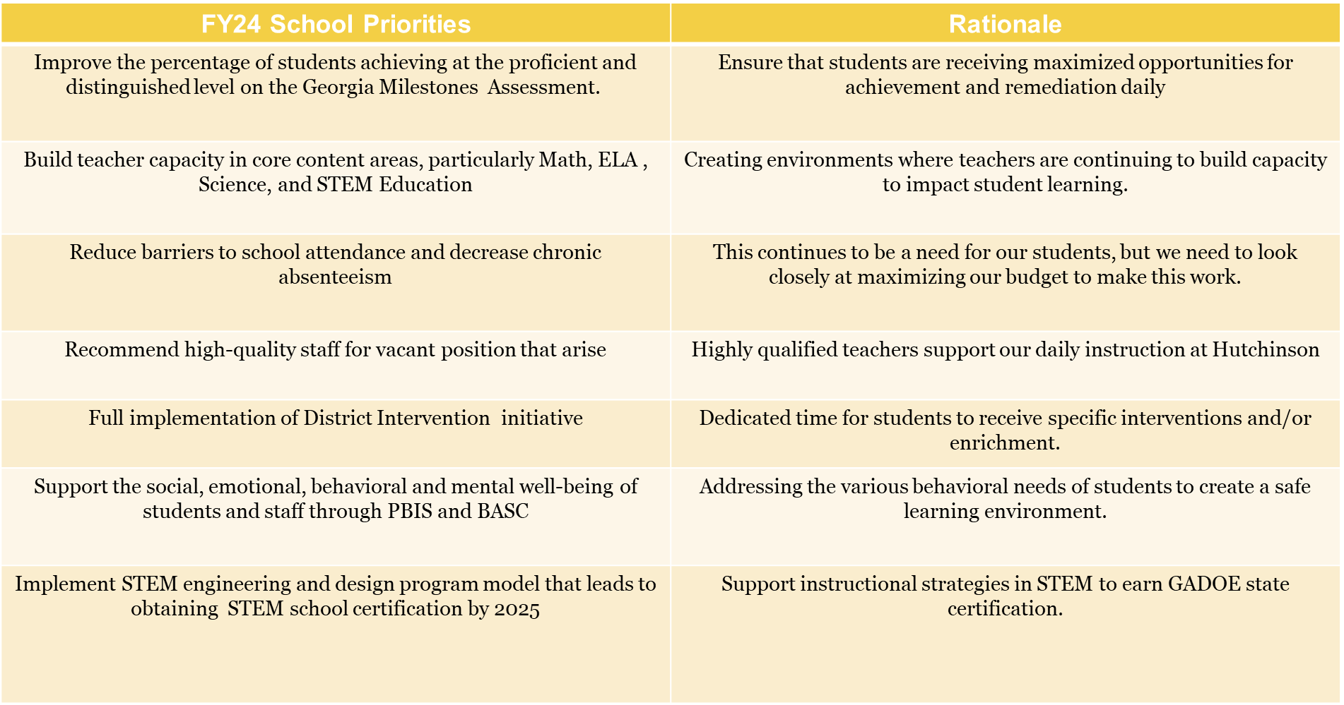
FY24 Budget Parameters
Notes:
Review the priorities that the GO Team has developed and the rationale for these priorities. Feel free to copy this slide if you have more than 3 priorities to account for.

Slide 7
Descriptions of Strategic Plan
Breakout Categories
Priorities: FY24 funding priorities from the school’s strategic plan, ranked by the order of importance.
APS Five Focus Area: What part of the APS Five is the priority aligned to?
Strategies: Lays out specific objectives for schools improvement.
Request: “The Ask” What needs to be funded in order to support the strategy?
Amount: What is the cost associated with the Request?

Slide 8
FY24 Strategic Plan Break-out
Priorities | APS FIVE Focus Area | Strategies | Requests | Amount
Recommend high-quality staff for vacant positions that arise | Curriculum and Instruction/Data/Personalized Learning | Hire Highly Effective Teachers to Replace Teachers that are retiring | Lose 1 Instructional Coach (going from 2 to 1 in general funds) Lose 1 4th Grade teaching position (36 student enrollment for FY24) Hire two new teachers to replace retiring teachers (3 teachers intend to leave in the upcoming school year) | Saves: $114,143 (IC) $90, 919 (teacher) Cost of teachers ($90,919 each)
Improve the percentage of students achieving at the proficient and distinguished level on the Georgia Milestones Assessment. | Curriculum and Instruction/Data/Personalized Learning | Hire Highly Effective Teachers to Replace Teachers that are retiring | Lose 1 Instructional Coach (going from 2 to 1 in general funds) Lose 1 4th Grade teaching position (36 student enrollment for FY24) Hire two new teachers to replace retiring teachers (3 teachers intend to leave in the upcoming school year) | Saves: $114,143 (IC) $90, 919 (teacher) Cost of teachers ($90,919 each)
Notes:
For the next few slides, I will show you how I have allocated the budget to support our strategic priorities.
Based on our strategic priorities and funds we received, here is a break-out of the priorities, which focus area it addresses, the strategies that will be implemented, the purchase request, which funding source was used and the amount.

Slide 9
Plan for FY24 CARES Allocation $(205,917)
Priorities | APS FIVE Focus Area | Strategies | Requests | Amount
Build teacher capacity in core content areas, particularly Math, ELA , Science, and STEM Education. | Curriculum and Instruction/Data/Personalized Learning | Hire an instructional expert to build teacher capacity in building consistently | Instructional Coach (211) | $114,143 (IC)
Support the social, emotional, behavioral and mental well-being of students and staff through PBIS and BASC | Whole child/Intervention | Hire staff member to communicate with the school and hammond park community (via social media and newsletter). Staff member will also assist with staff and student morale in addition to celebrations | School Communications Liaison (Hourly) | $29,352 (48 weeks, 25 hours per week)
Build teacher capacity in core content areas, particularly Math, ELA , Science, and STEM Education. | Curriculum and Instruction/Data | Pay teachers stipends for leading grade level teams, vertical alignment teams and overall school improvement teams. | Stipends for teacher leaders and School improvement (All grade level chairs) | $16,000
Improve the percentage of students achieving at the proficient and distinguished level on the Georgia Milestones Assessment. | Curriculum and Instruction/ Whole Child Intervention | Hire a paraprofessional to support building initiatives and small groups instruction in 1-2 classrooms | Paraprofessional (202) | $44,197
Notes:
For the next few slides, I will show you how I have allocated the budget to support our strategic priorities.
Based on our strategic priorities and funds we received, here is a break-out of the priorities, which focus area it addresses, the strategies that will be implemented, the purchase request, which funding source was used and the amount.

Slide 10
Plan for FY24 Title I Family Engagement Funds
$6,000
Priorities | APS FIVE Focus Area | Strategies | Requests | Amount
Reduce barriers to school attendance and decrease chronic absenteeism | Whole Child/Intervention | Care Team Support for student monthly attendance celebrations | Funds to support intervention efforts to support attendance initiatives | $1000
Improve the percentage of students achieving at the proficient and distinguished level on the Georgia Milestones Assessment. Support the social, emotional, behavioral and mental well-being of students and staff through PBIS and BASC | Curriculum and Instruction/ Whole Child/Intervention | Academic Parent Teacher Teams Family Engagement Model- Teachers and Parents come together 3 times a year to work on Foundational Skills with students. | Funds to purchase items for make and take resources for each parental meeting. | $5000
Notes:
For the next few slides, I will show you how I have allocated the budget to support our strategic priorities.
Based on our strategic priorities and funds we received, here is a break-out of the priorities, which focus area it addresses, the strategies that will be implemented, the purchase request, which funding source was used and the amount.

Slide 11
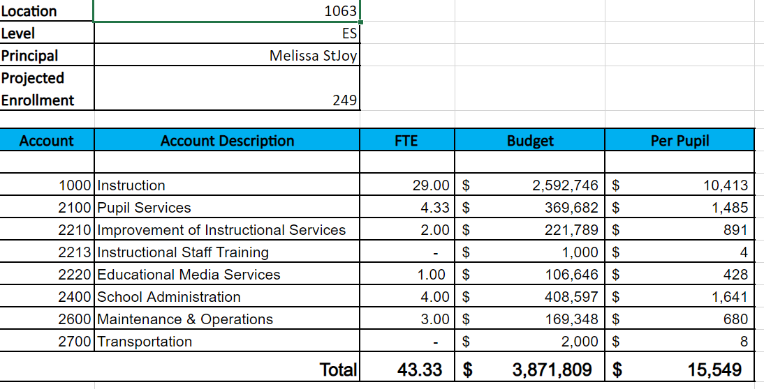
Budget by Function (Required)
*Based on Current Allocation of School Budget
Notes:
I am passing out the definitions for these funding categories. You will see what makes up each category. Although the school’s total budget amount will not change, allocation per function may change depending on our conversations and school needs.

Slide 12
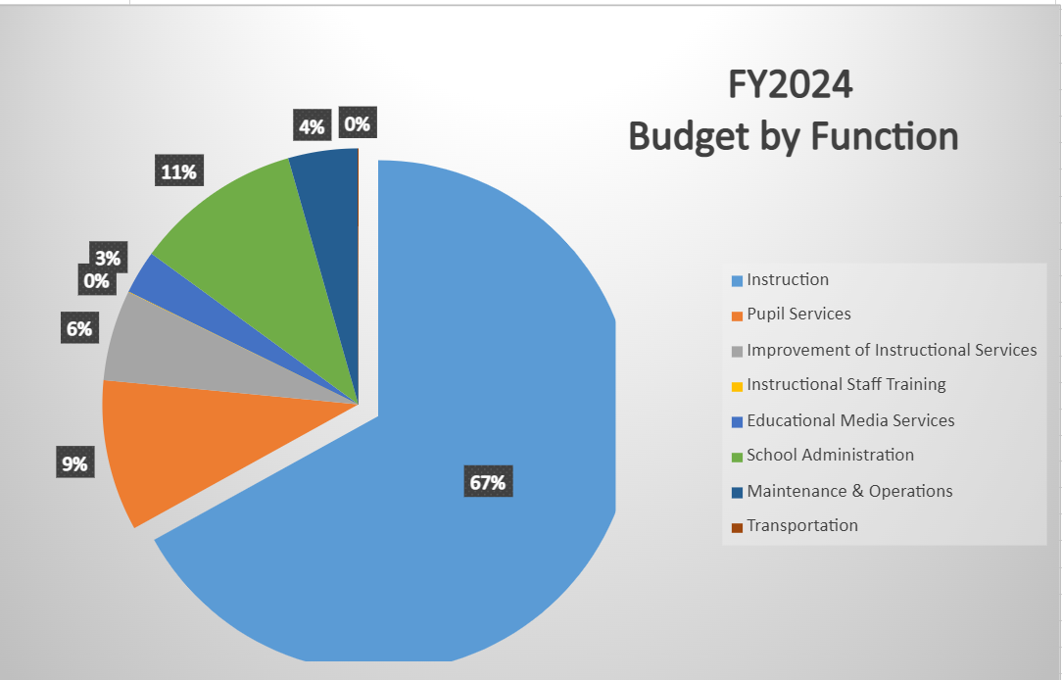
Budget by Function (Required)
*Based on Current Allocation of School Budget
Notes:
Explain the pie chart and allocations

Slide 13
DISCUSSION OF RESERVE AND HOLDBACK FUNDS

Slide 14
Plan for FY24 Leveling Reserve
$52,261
Priorities | APS FIVE Focus Area | Strategies | Requests | Amount
Improve the percentage of students achieving at the proficient and distinguished level on the Georgia Milestones Assessment. | Curriculum and Instruction/Data/Personalized Learning | Teacher Tutoring to push into grades to support small group instruction based on data | Hire Hourly Teacher Tutors to focus on Domain Specific content to close instructional GAPS | Hourly Rate :$32.37 48 weeks/25 hours a week $38,844
Improve the percentage of students achieving at the proficient and distinguished level on the Georgia Milestones Assessment. | Curriculum and Instruction | Purchase instructional Materials as needed | Fill any gaps to purchase materials to support instruction | $13,417
Notes:
For the next few slides, I will show you how I have allocated the budget to support our strategic priorities.
Based on our strategic priorities and funds we received, here is a break-out of the priorities, which focus area it addresses, the strategies that will be implemented, the purchase request, which funding source was used and the amount.

Slide 15
Plan for FY24 Title I Holdback $ -$19,584
Priorities | APS FIVE Focus Area | Strategies | Requests | Amount
Notes:
For the next few slides, I will show you how I have allocated the budget to support our strategic priorities.
Based on our strategic priorities and funds we received, here is a break-out of the priorities, which focus area it addresses, the strategies that will be implemented, the purchase request, which funding source was used and the amount.

Slide 16
QUESTIONS FOR THE GO TEAM TO CONSIDER AND DISCUSS
Are our school’s priorities (from your strategic plan) reflected in this budget?
Are new positions and/or resources included in the budget to address our major priorities?
Do we know (as a team) the plan to support implementation of these priorities beyond the budget (ex. What strategies will be implemented)?
What tradeoffs are being made in order to support these priorities?
How are district and cluster priorities reflected in our budget?
Cluster priorities- what staff, materials, etc. are dedicated to supporting our cluster’s priorities?
Signature programs- what staff, materials, etc. are dedicated to supporting our signature program?
Are there positions our school will share with another school, i.e. nurse, counselor?
Notes:
CHAIR - Our final task for today! Here are questions that we need to consider to ensure we have a good working draft budget. Let’s walk through them together.

Slide 17
Where We’re Going?
Our next meeting is the Budget Approval Meeting
What:
During this meeting we will review the budget, which should be updated based on feedback from the staffing conference, Associate Superintendents, and key leaders. After review, GO Teams will need to take action (i.e., vote) on the FY24 Budget.
Why:
Principals will present the final budget recommendations for GO Team approval.
When:
All approval meetings must be held after staffing conferences. Budgets must be approved by March 17th.

Slide 18
What’s Next?
February
HR Staffing Conferences (February 23rd)
March
Final GO Team Approval Meeting (AFTER your school’s Staffing Conference and BEFORE Friday, March 17th)
Notes:
In February, we will meet again to discuss how the school’s budget has been allocated to support the programmatic needs and FY23 key strategic priorities.
If think we need to continue our budget conversations, we will schedule additional meetings. My goal is to make sure your voices are reflected in our school’s budget.
I will also be meeting with my Associate Superintendent, program managers and other key leaders to go over our budget and to make sure the school is meeting the standards of service and appropriately staffing.
During the week of Feb. 24th -March 2nd , HR Staffing Conferences will be held. At this meeting, I will present my plan for staff utilization, resource distribution and plan for staffing implications.
We will need to approve the budget at the ________ meeting.

